Slide 1
HAMILTON STATE QUALIIFIERS POULTRY CDE 2015

Slide 2
BONE-IN MEAT PRODUCTS

Slide 3
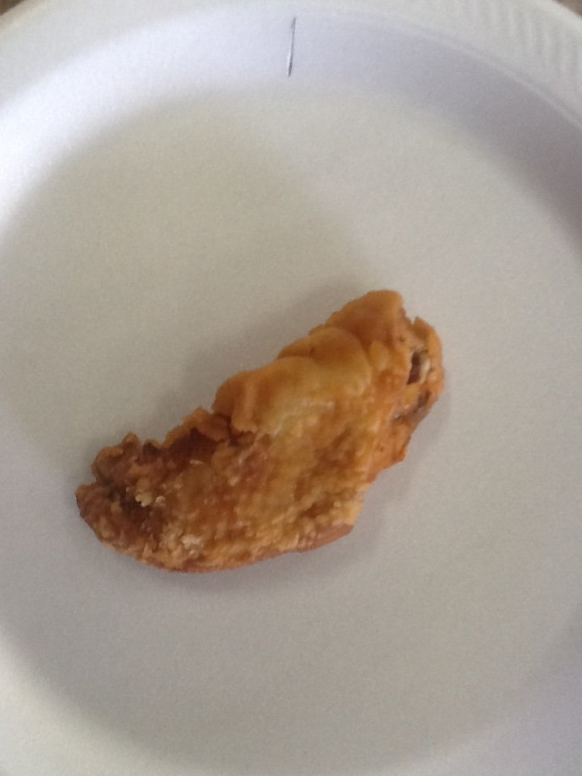
MISCUT

Slide 4
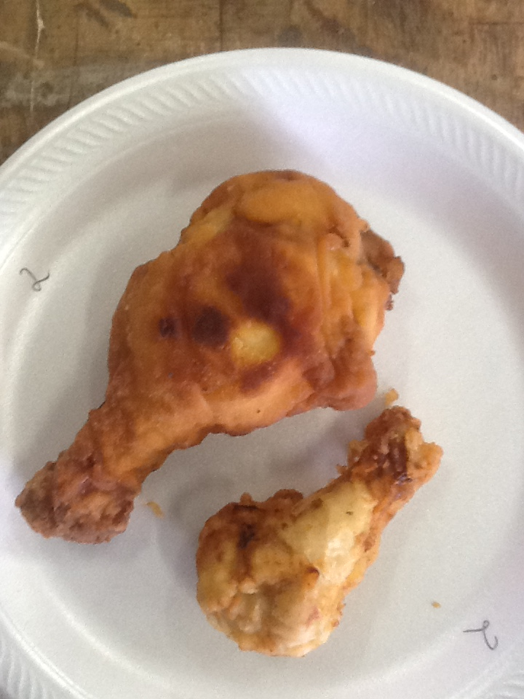
COLOR,
MIXED PROD

Slide 5
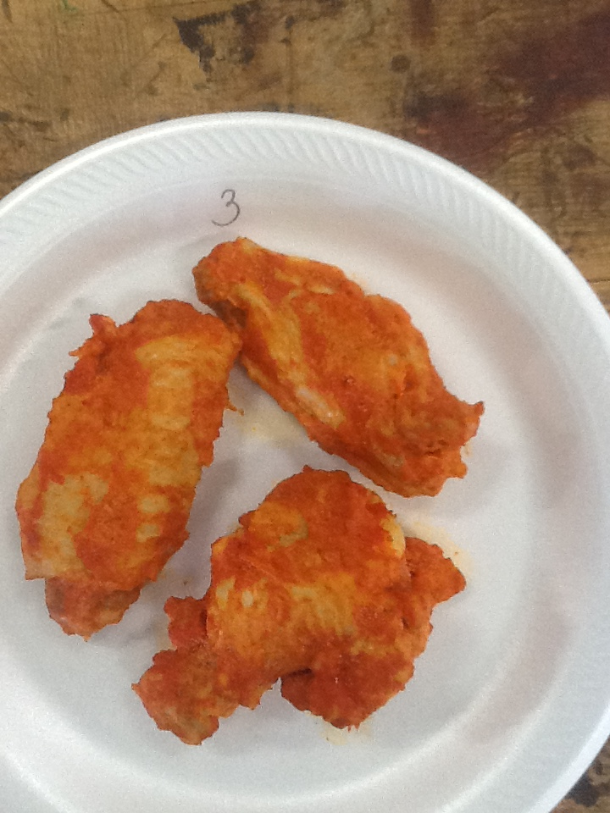
MIXED PRODUCT

Slide 6
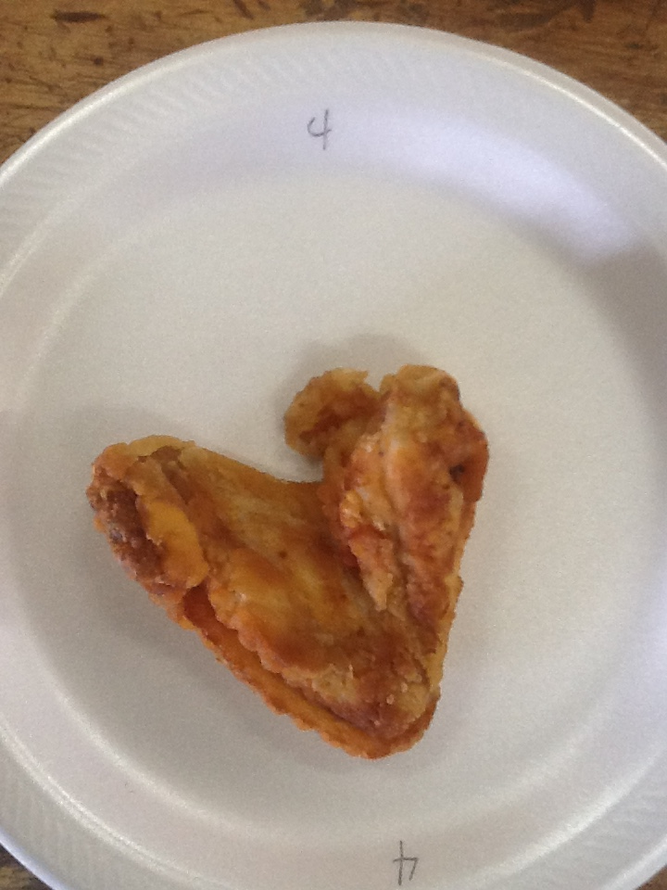
MISCUT

Slide 7
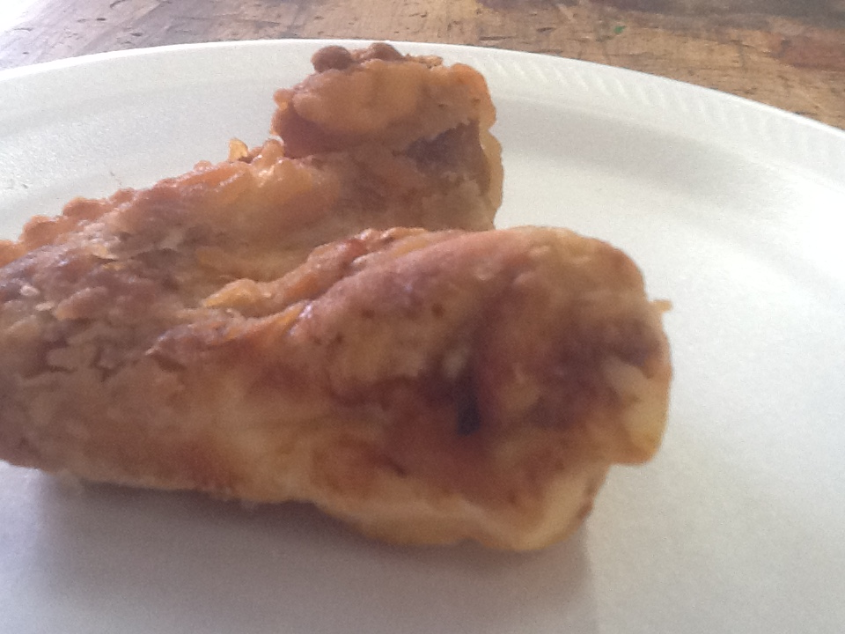
SIDEVIEW OF #4
PORTION OF THE WIING TIP IS PRESENT

Slide 8
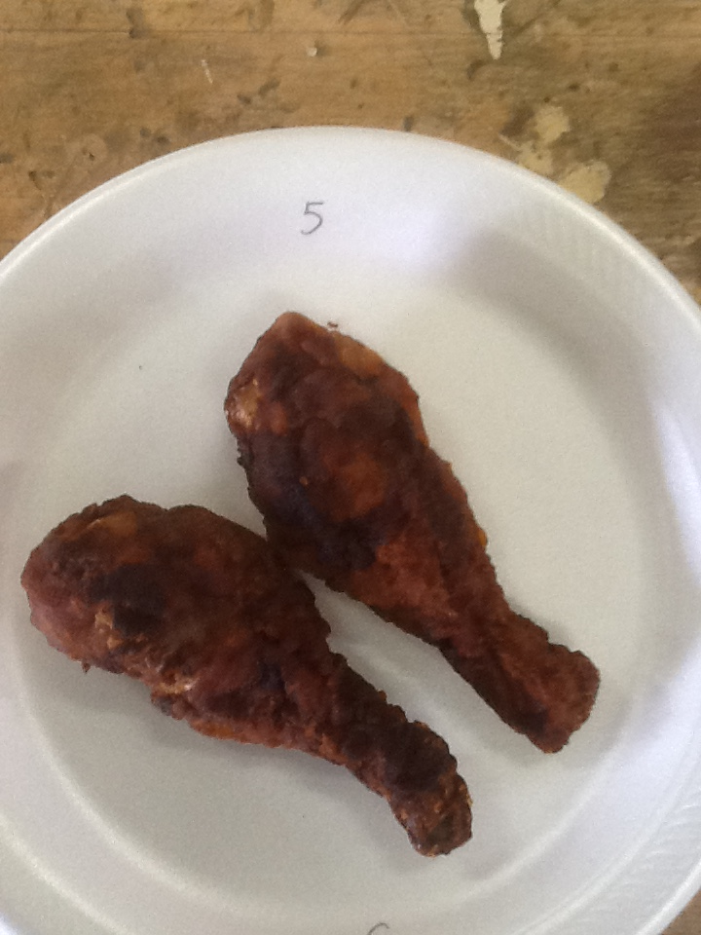
INCONSISTENT
COLOR

Slide 9
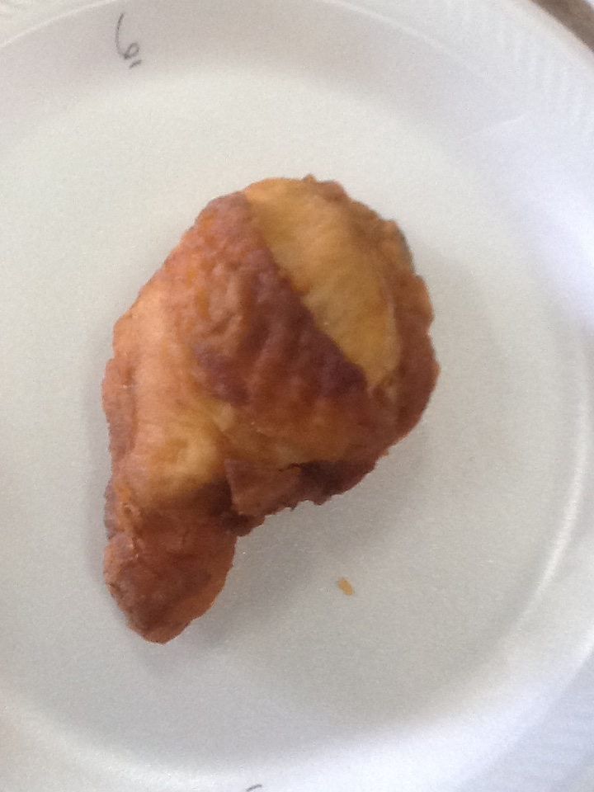
BROKEN/BROKEN
BONE

Slide 10
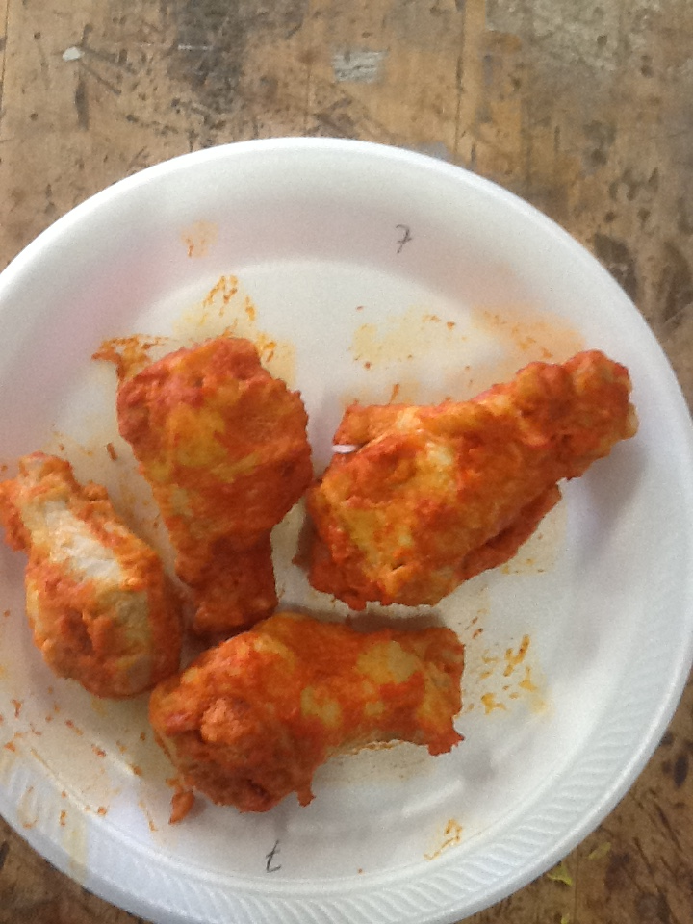
COATING VOID, FOREIGN

Slide 11
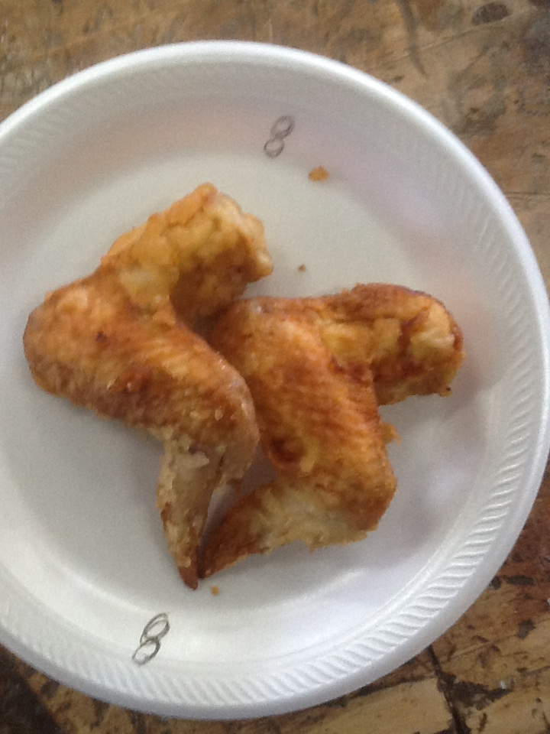
MISCUT

Slide 12
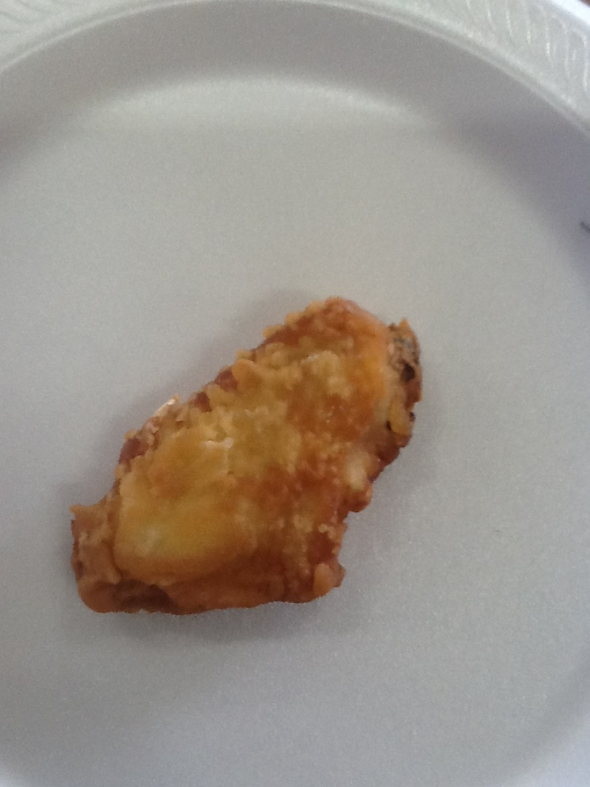
MISCUT

Slide 13
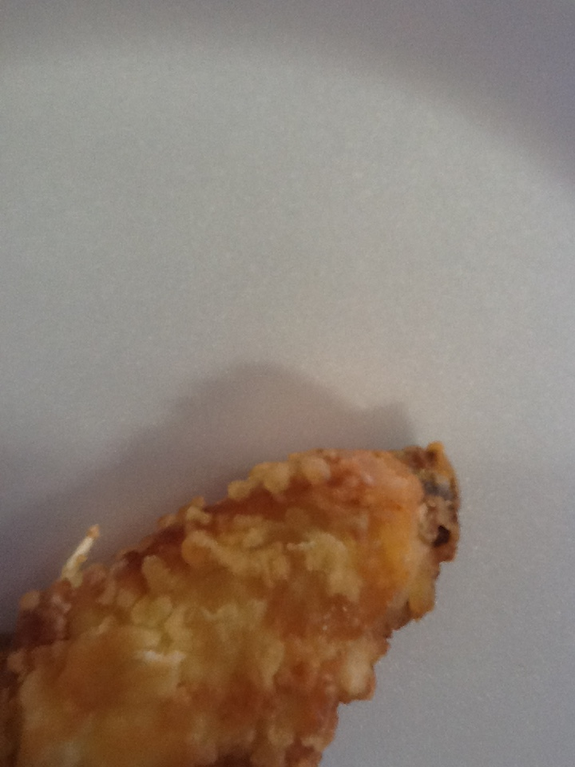

Slide 14
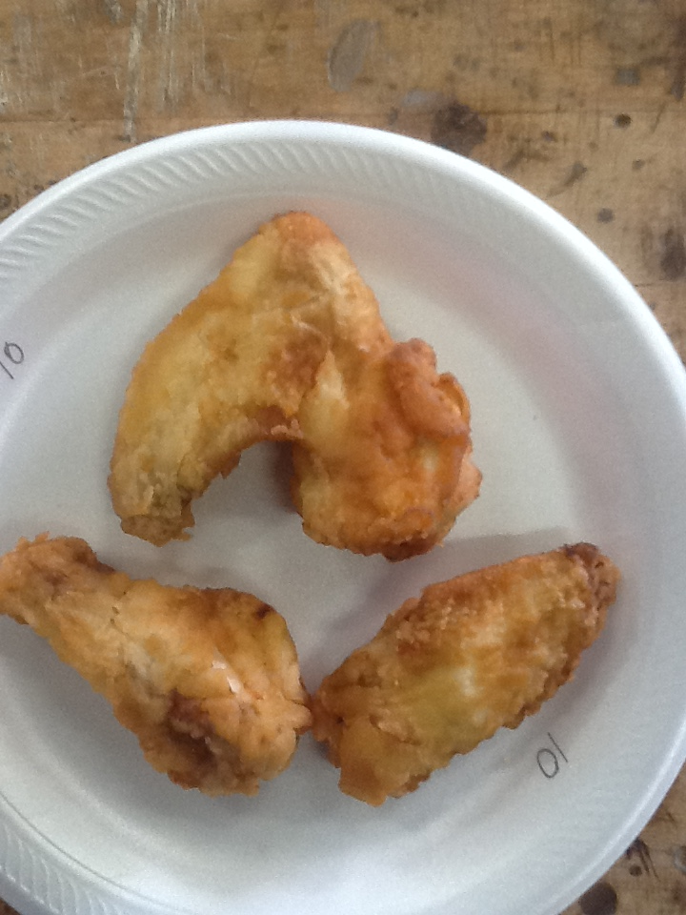
MISCUT

Slide 15
EXTERIOR EGG FACTORS
AND
GRADING

Slide 16
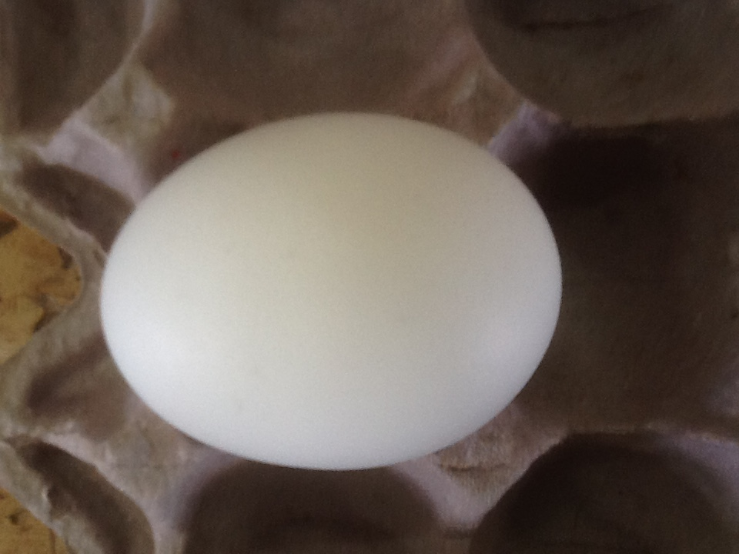
NO DEFECT
(AA/A)

Slide 17
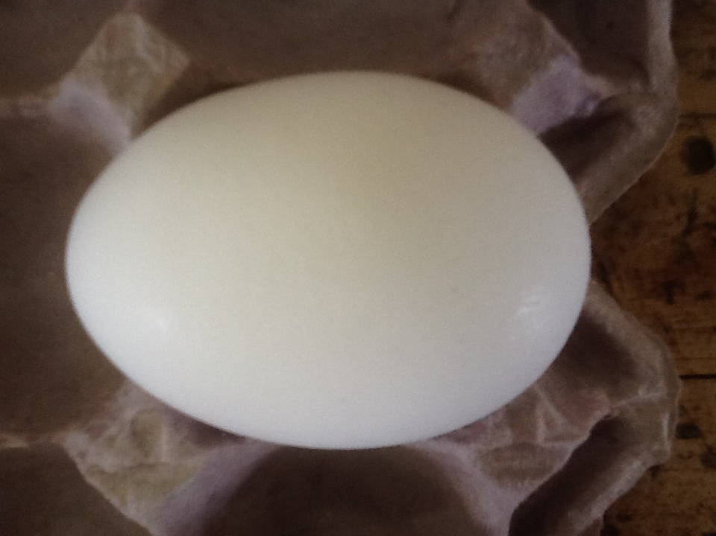
NO DEFECT
(AA/A)

Slide 18
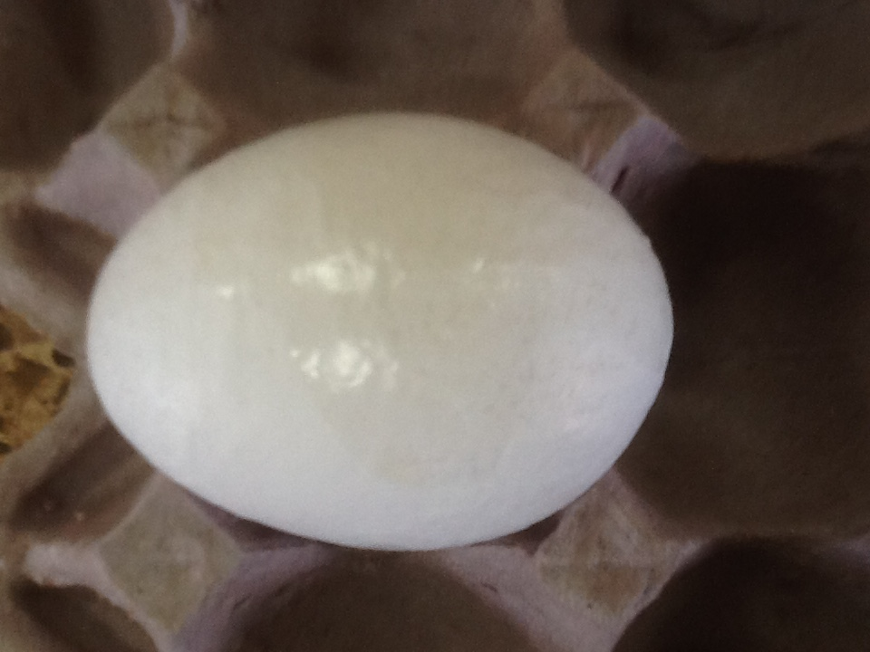
PRONOUNCED RIDGES AND ADHERING MATERIAL (ALBUMEN)
(N/G)

Slide 19
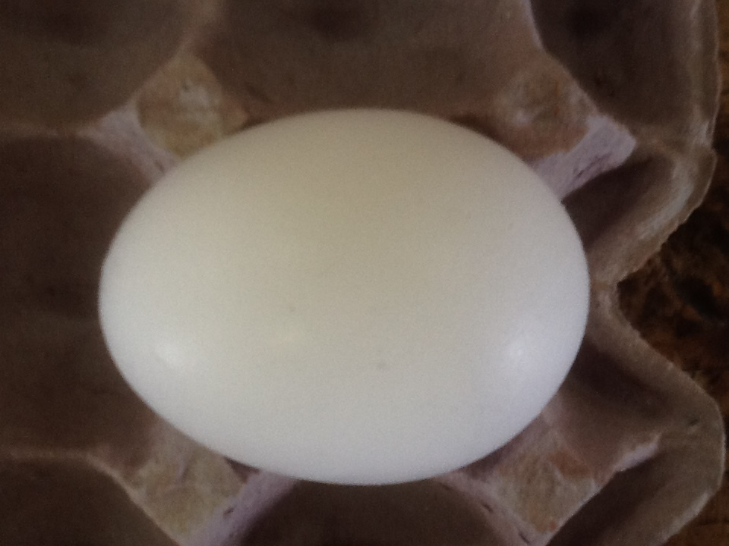
CHECKED (N/G)

Slide 20
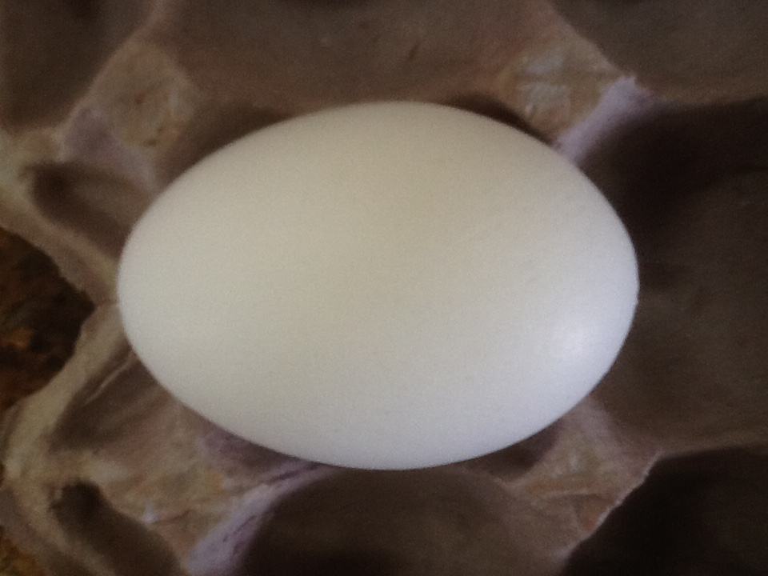
NO DEFECT
(AA/A)

Slide 21
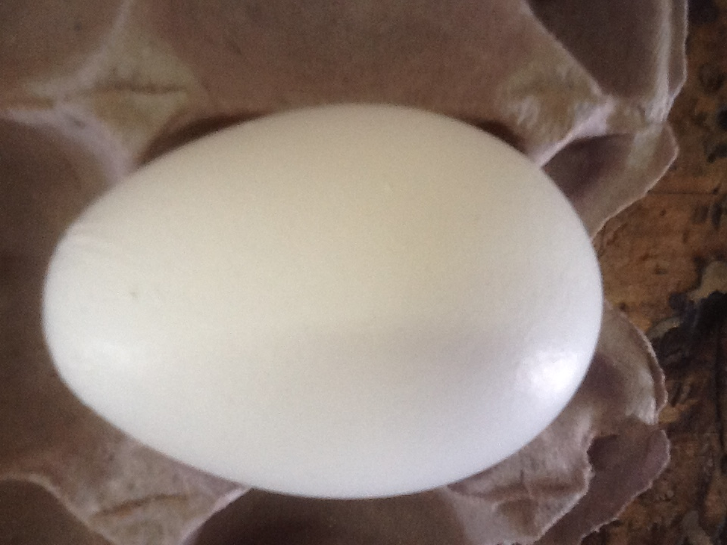
PRONOUNCED RIDGES (B)

Slide 22
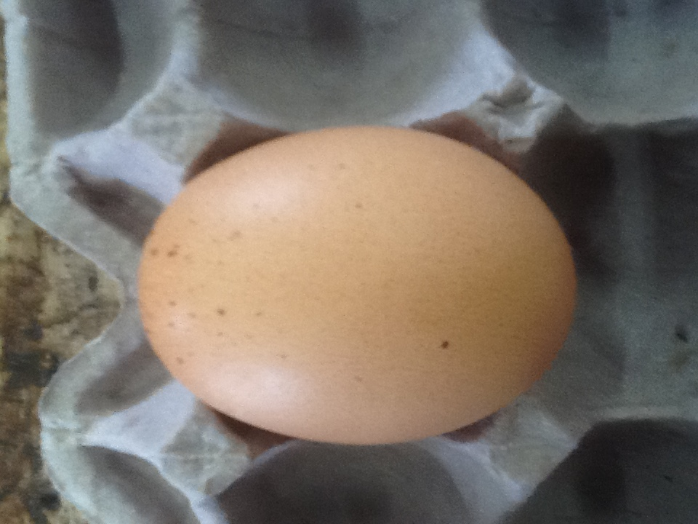
NO DEFECT
(AA/A)

Slide 23
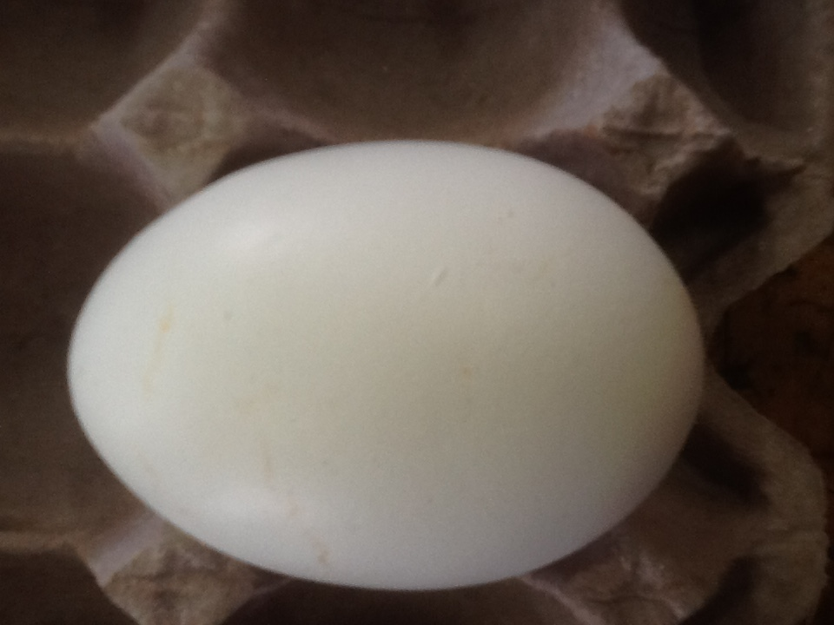
SLIGHT/MODERATE
STAIN (B)

Slide 24
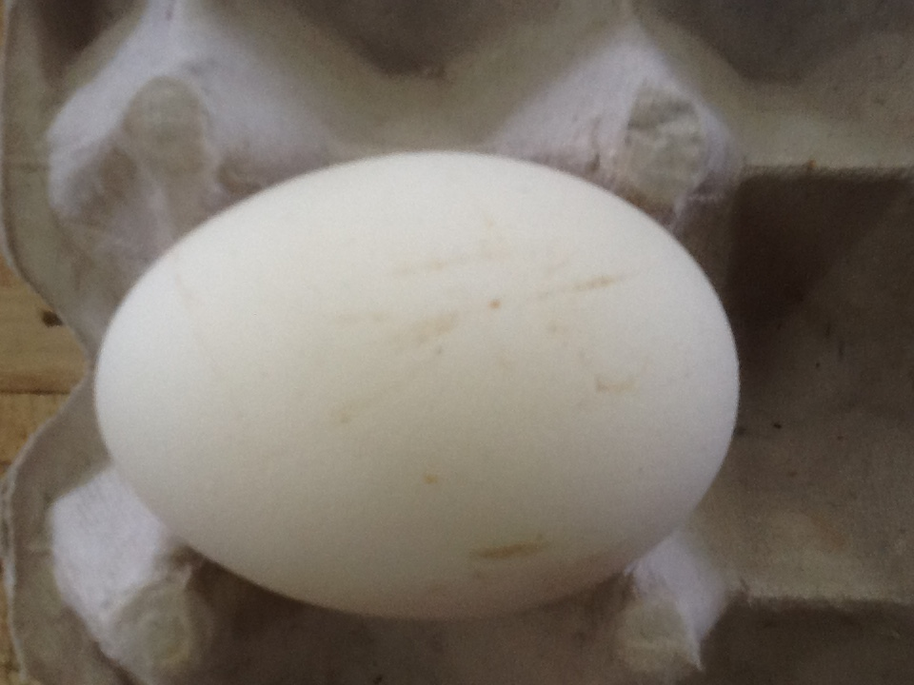
PROMINENT STAIN (N/G)

Slide 25
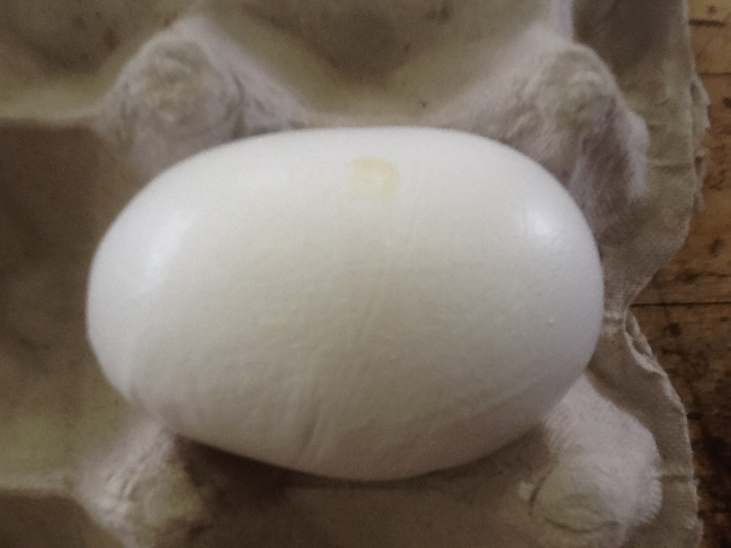
ADHEREING/FOREIGN
DECIDEDLY MISSAHPEN
PRONOUNCED RIDGES (N/G)

Slide 26
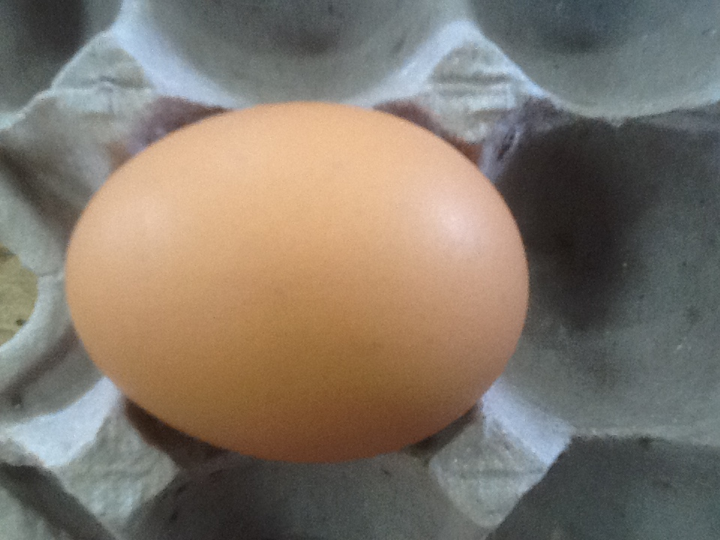
NO DEFECT
(AA/A)

Slide 27
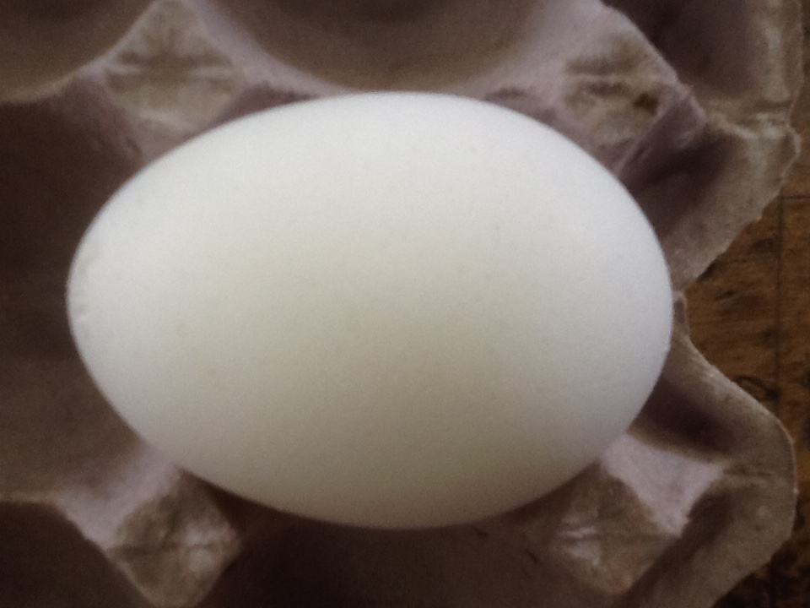
LARGE CALCIUM DEPOSITS (B)

Slide 28
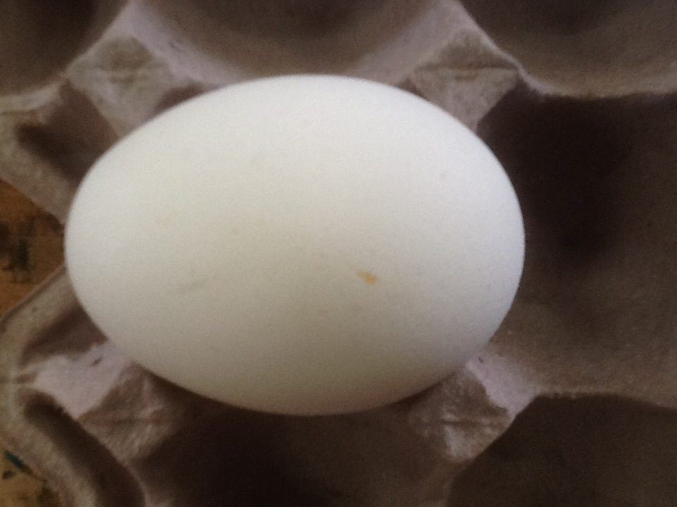
SLIGHT/MODERATE STAIN
(B)

Slide 29
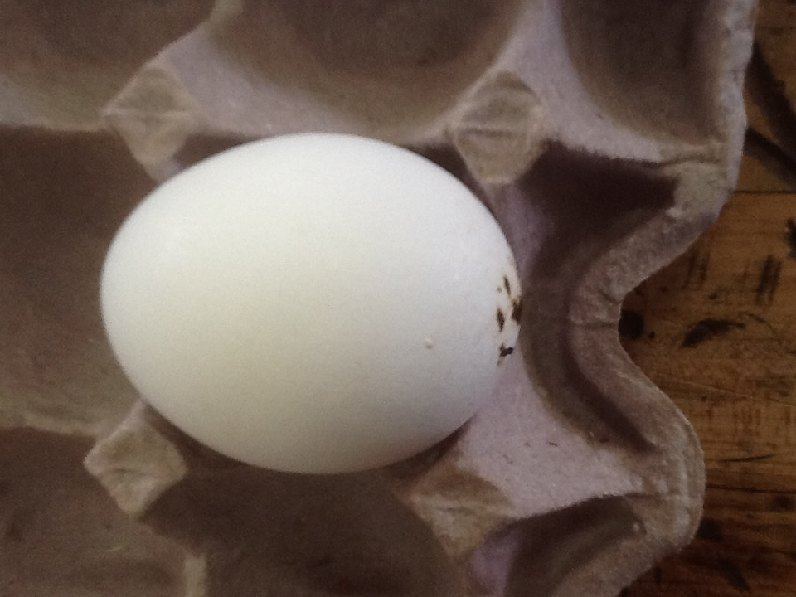
ADHEREING/FOREIGN
(N/G)

Slide 30
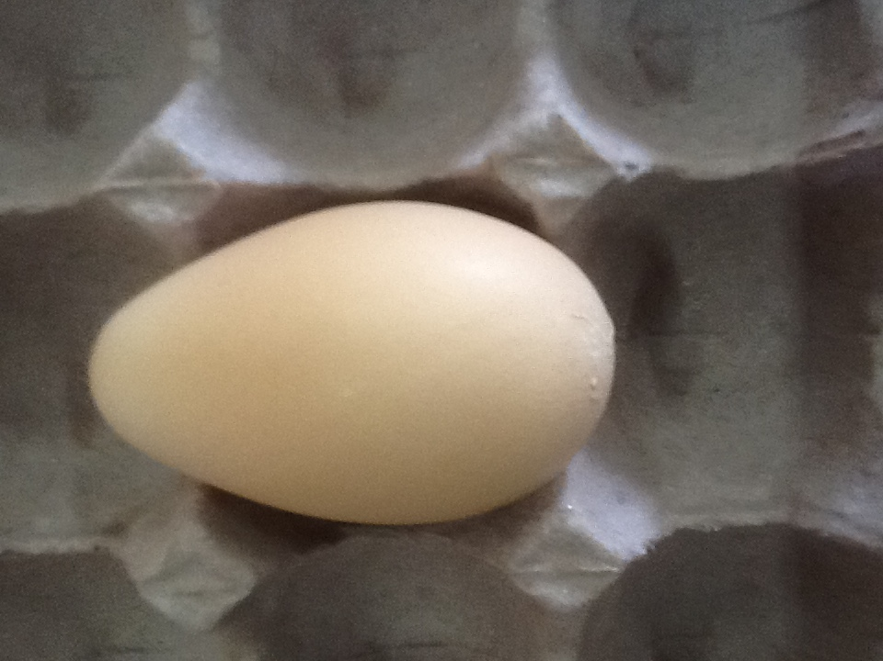
DECIDEDLY MISSHAPEN
LARGE CALCIUM DEPOSITS
(B)

Slide 31
BONELESS MEAT PRODUCTS

Slide 32
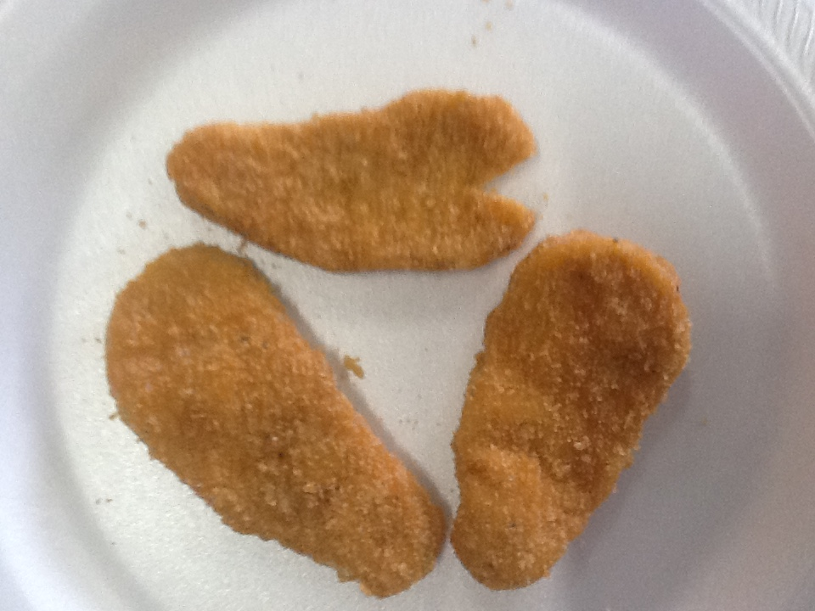
SHAPE/SIZE
BROKEN/INCOMPLETE

Slide 33
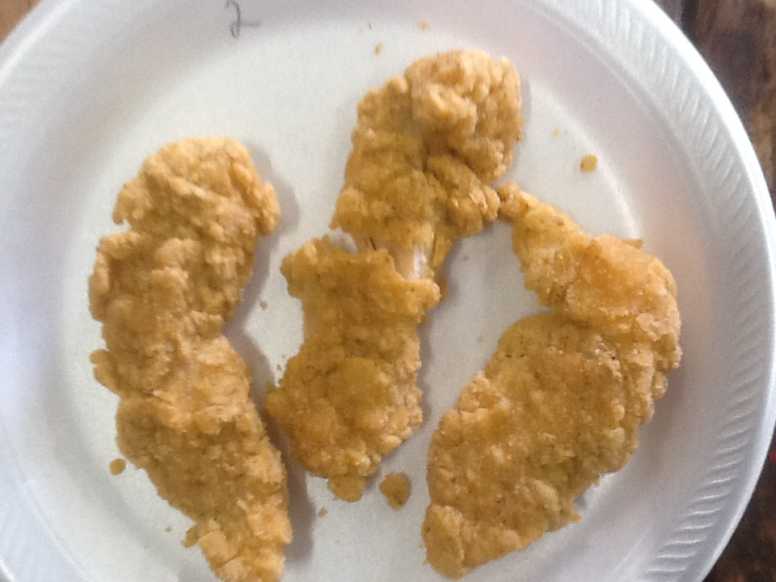
SHAPE/SIZE
BROKEN/INCOMPLETE

Slide 34
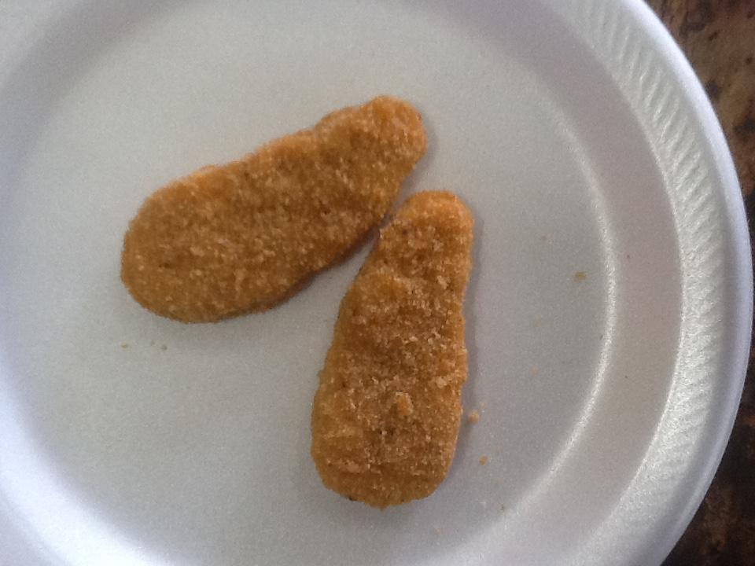
NO DEFECT

Slide 35
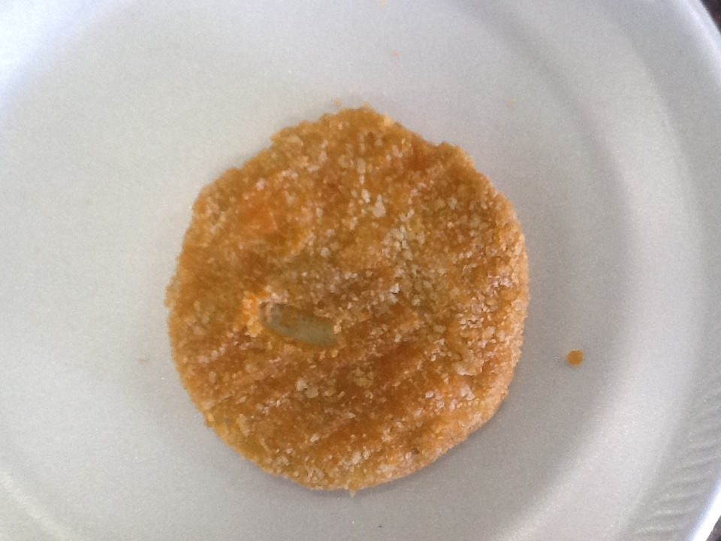
COATING VOID

Slide 36
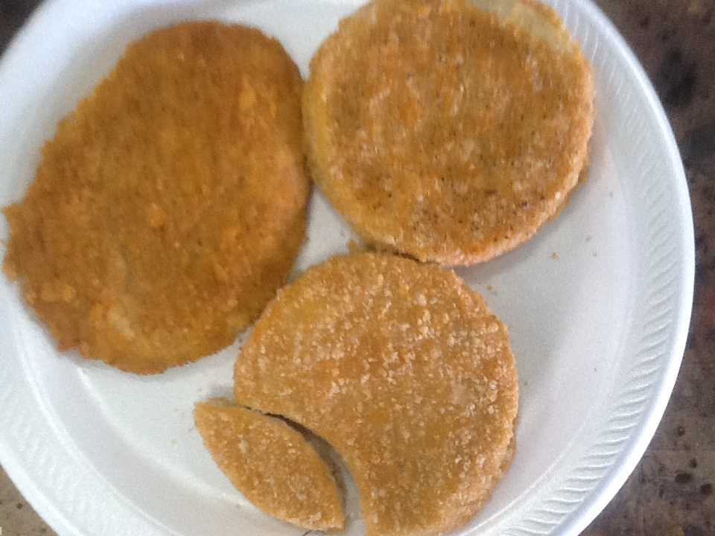
COATING VOID
INCONSISTENT COLOR
SHAPE/SIZE
BROKEN/INCOMPLETE
FOREIGN MATERIAL

Slide 37
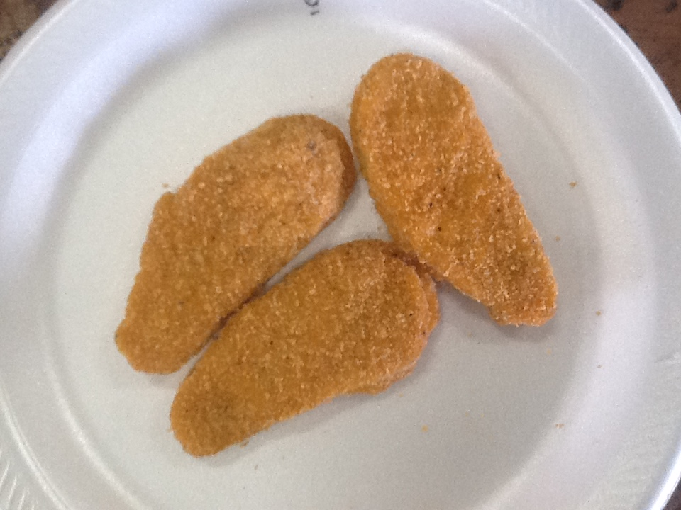
NO DEFECT

Slide 38
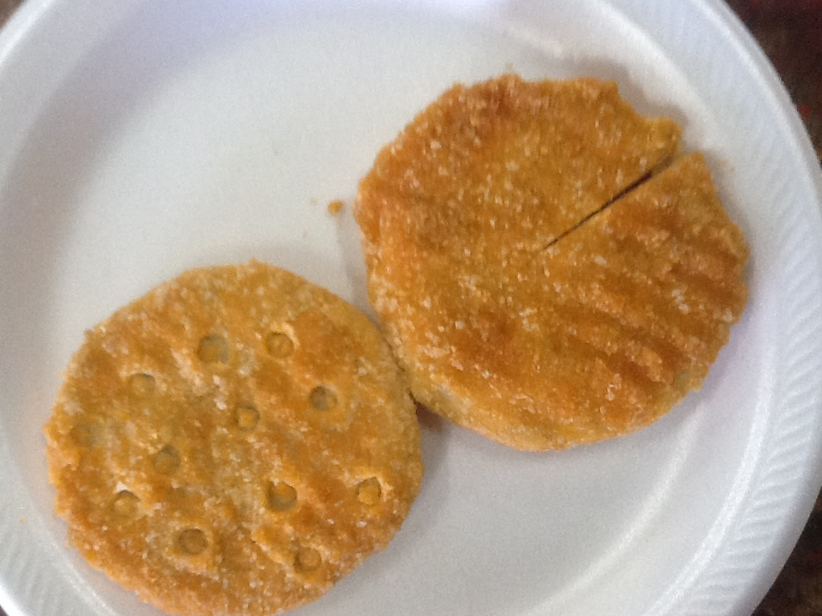
INCONSISTENT COLOR
BROKEN/INCOMPLETE
FOREIGN MATERIAL

Slide 39
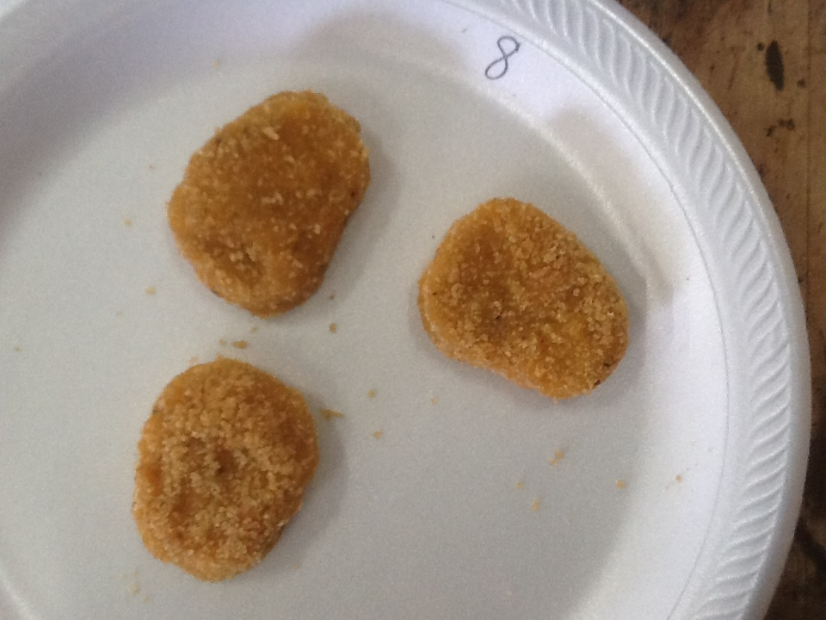
NO DEFECT

Slide 40
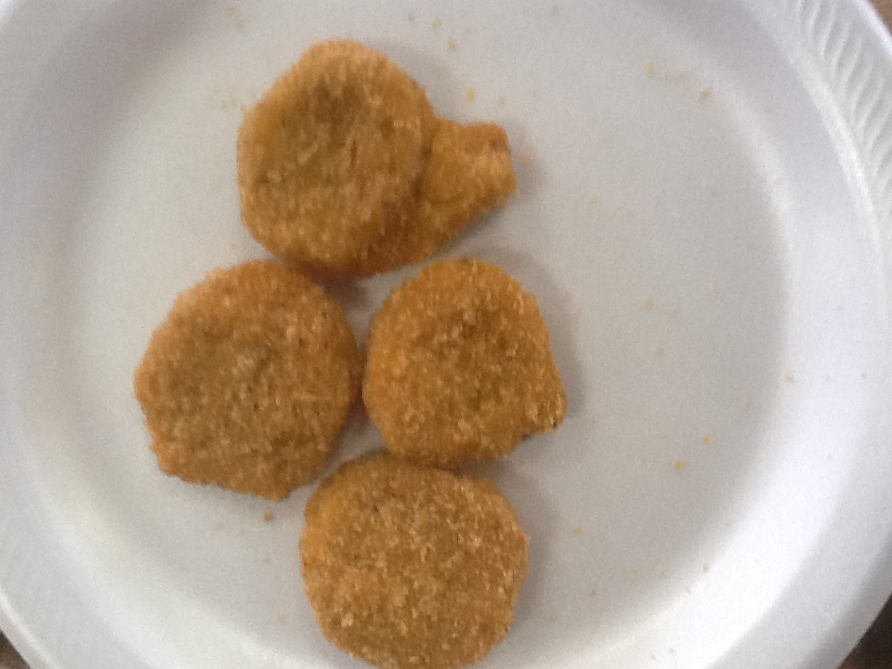
SHAPE/SIZE
CLUSTER/MARRIAGES

Slide 41
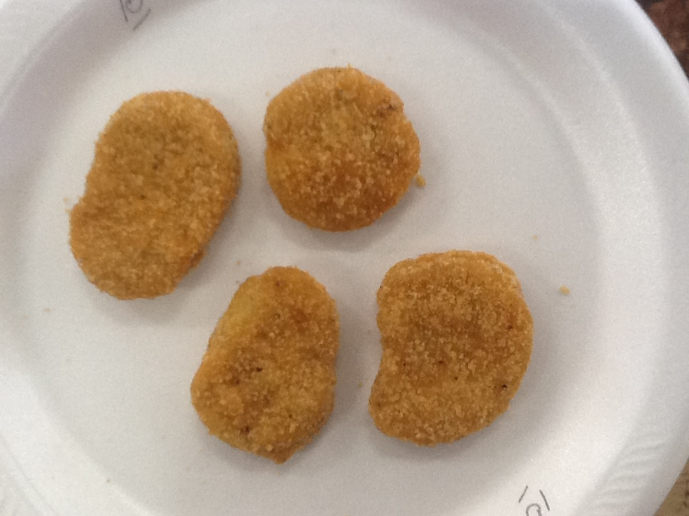
SHAPE/SIZE

Slide 42
IDENTIFICATION OF CARCASS PARTS

Slide 43
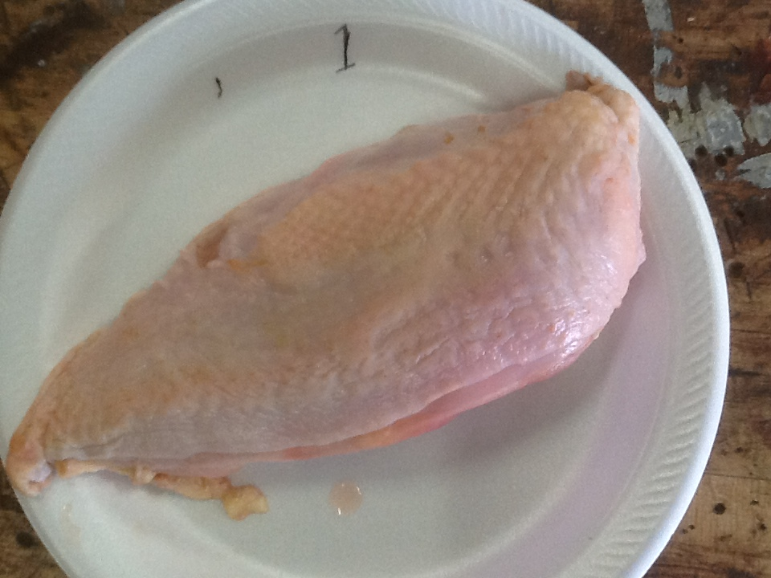
SPLIT BREAST

Slide 44
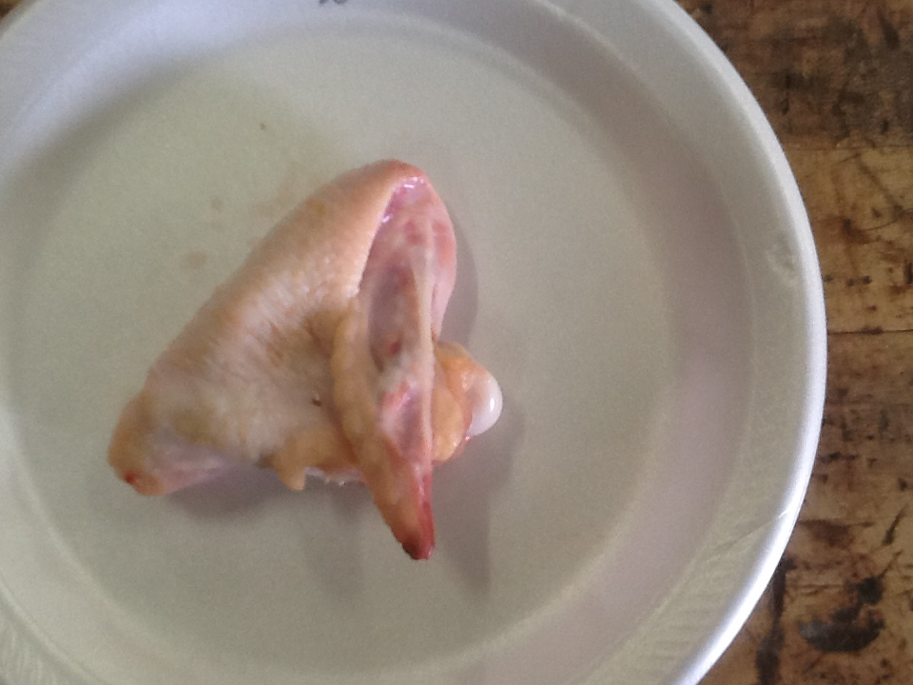
WING

Slide 45
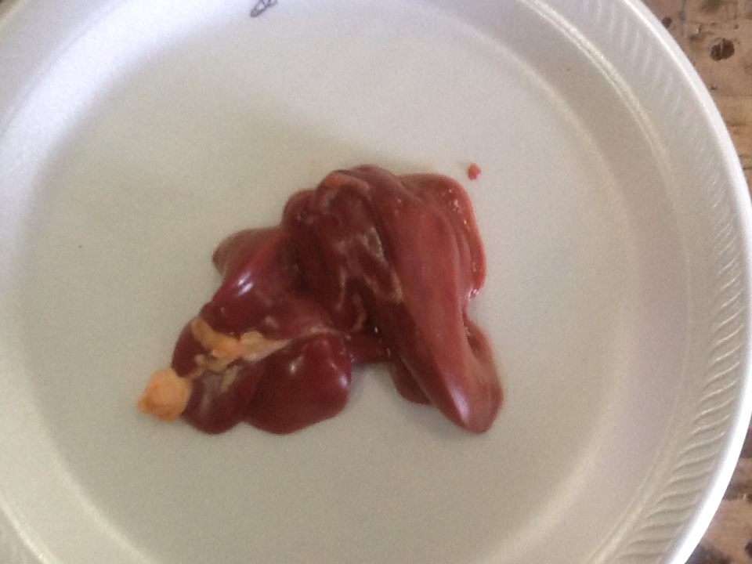
LIVER

Slide 46
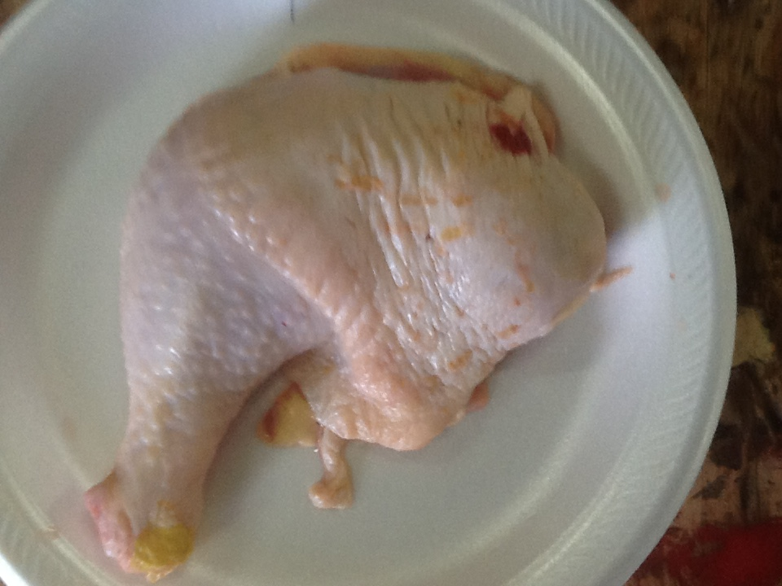
LEG

Slide 47
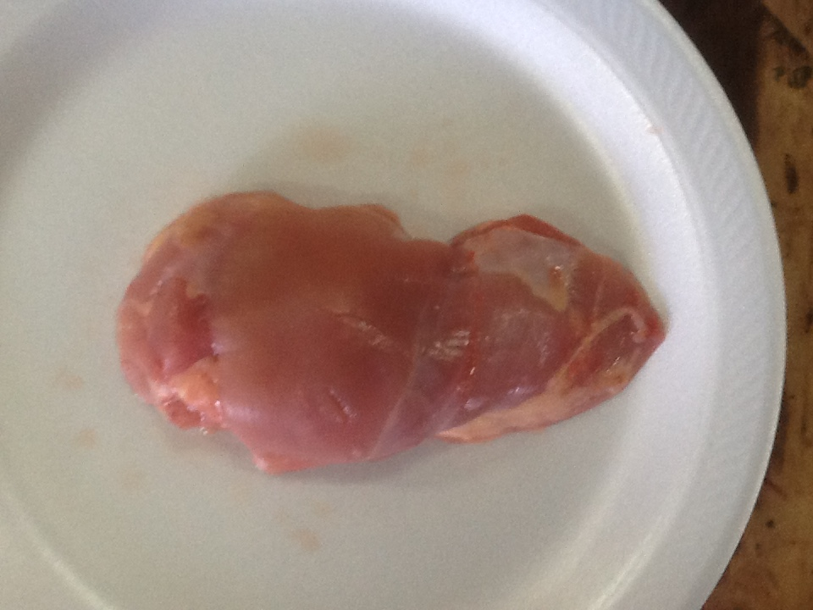
B/S THIGH

Slide 48
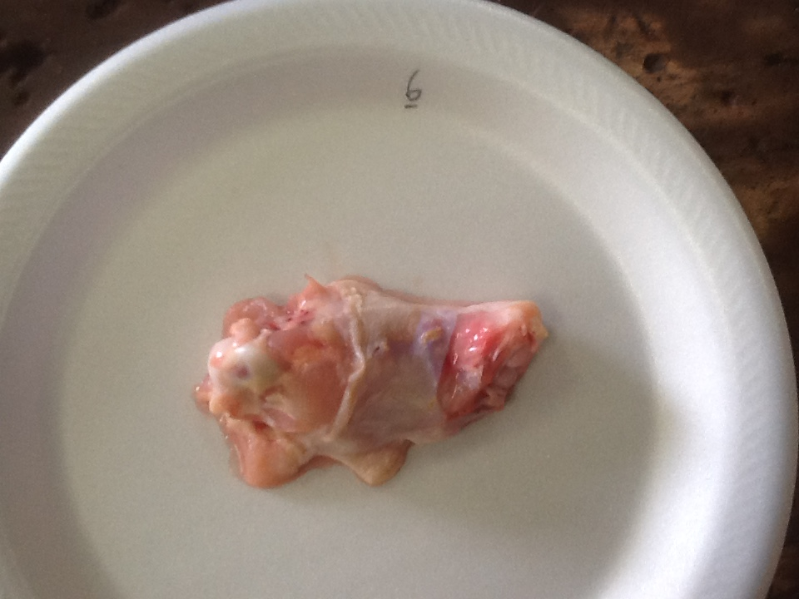
DRUMETTE

Slide 49
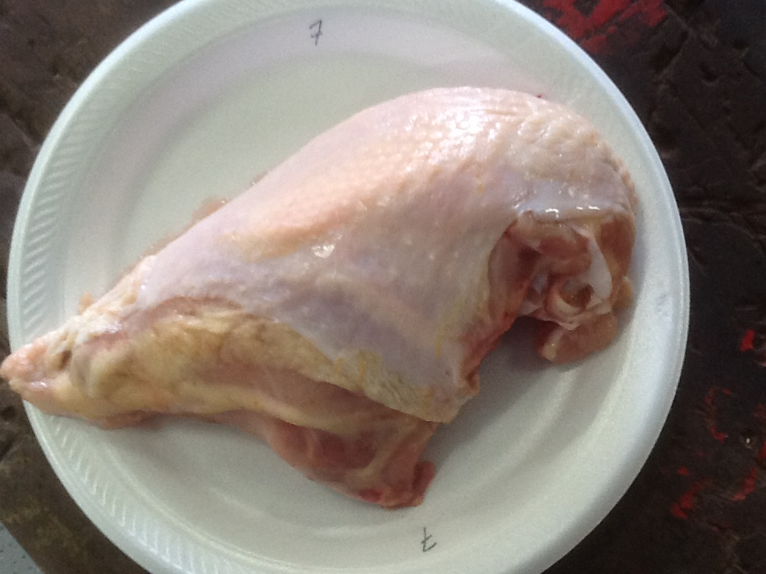
SPLIT BREAST WITH
RIBS

Slide 50
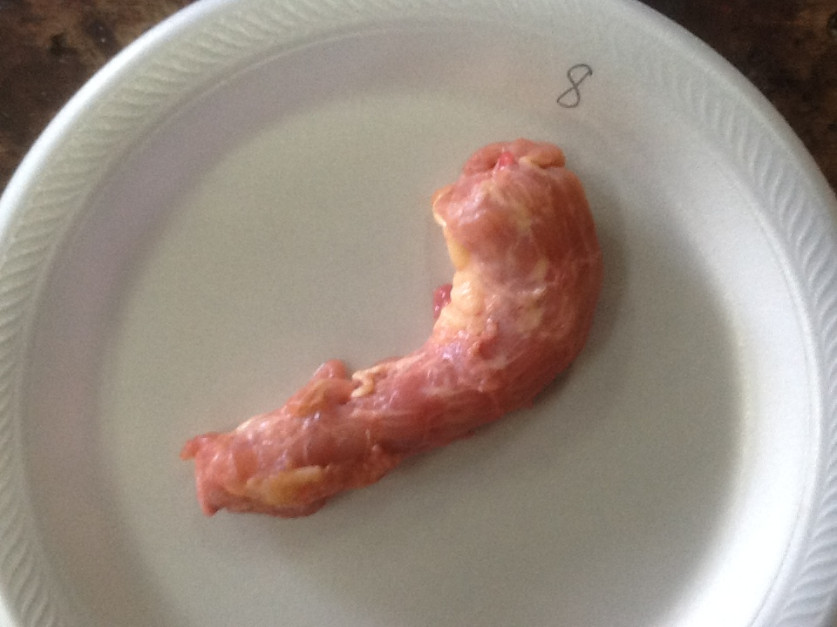
NECK

Slide 51
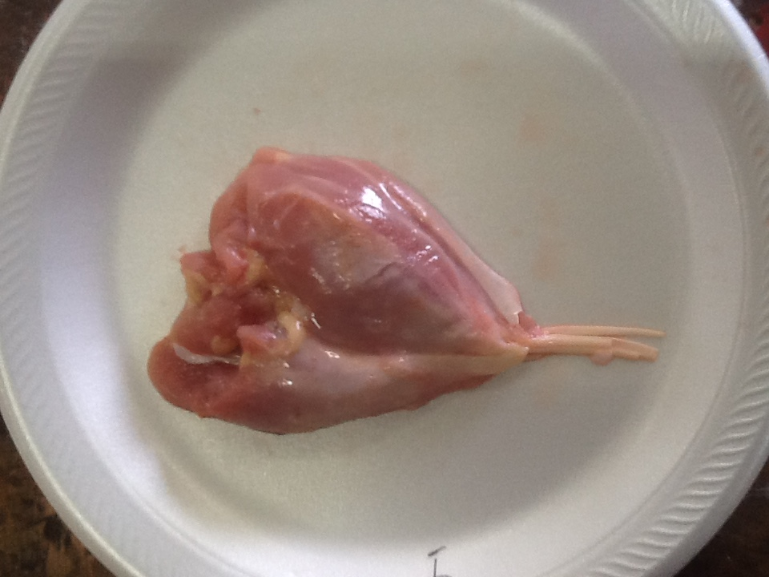
B/S DRUM

Slide 52
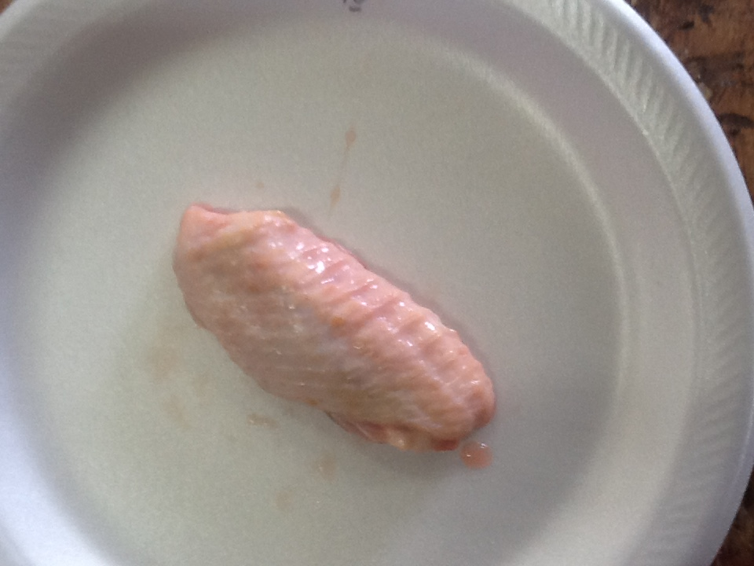
WING PORTION

Slide 53
CARCASS GRADING

Slide 54
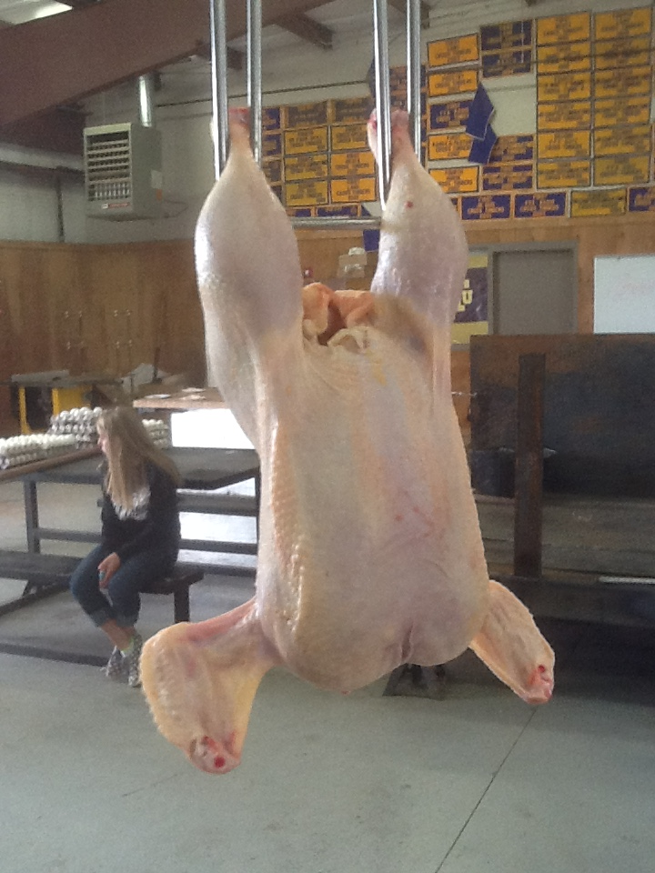
A

Slide 55
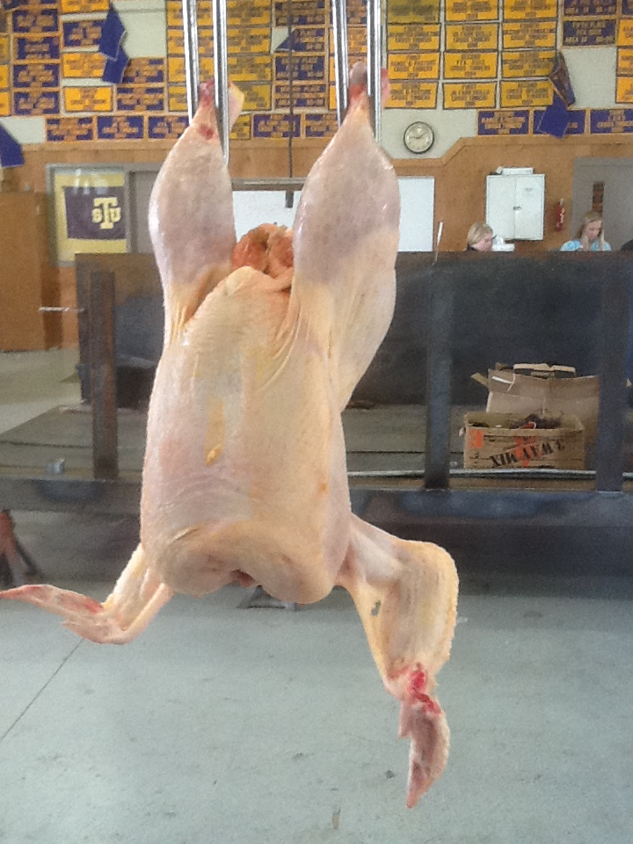
B

Slide 56
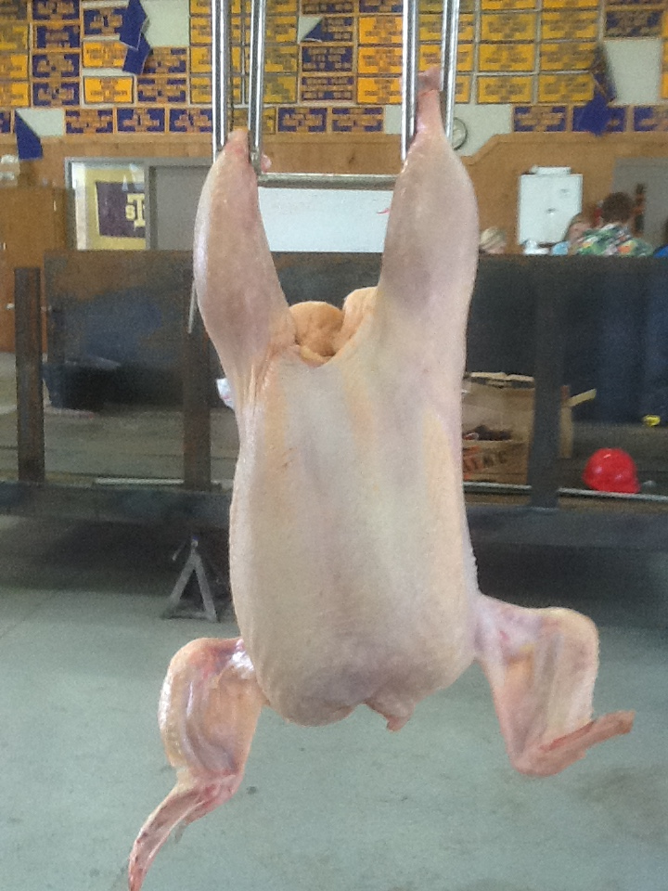
C -2 BROKENS

Slide 57
B

Slide 58
C

Slide 59
N/G

Slide 60
N/G

Slide 61
B

Slide 62
C

Slide 63
B

Slide 64
HENS

Slide 65
#1

Slide 66
#2

Slide 67
#4

Slide 68
#4

Slide 69
#1 #2 #3 #4
PLACING 1-2-3-4
CUTS 3-2-3

Slide 70
TURKEYS

Slide 71
A

Slide 72
B

Slide 73
B

Slide 74
N/G

Slide 75
#3
#2

Slide 76
TURKEY PLACING
1-2-3-4
CUTS 5-3-5

Slide 77
INTERIOR EGGS

Slide 78
AA

Slide 79
A

Slide 80
A

Slide 81
A

Slide 82
B

Slide 83
B

Slide 84
LOSS

Slide 85
B

Slide 86
A

Slide 87
LOSS
BLOOD SPOT(WAS NOT SCORED IN OFFICIAL)

